Slide 1

Deep Reinforcement Learning for Automated Stock Trading: An Ensemble Strategy
Gopi M. tatiraju

Slide 2
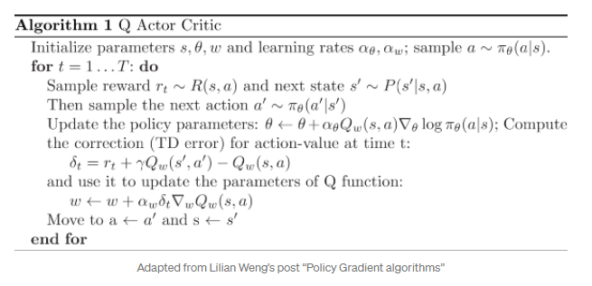
Actor Critic Methods
The “Critic” estimates the value function. This could be the action-value (the Q value) or state-value (the V value).
The “Actor” updates the policy distribution in the direction suggested by the Critic (such as with policy gradients).
and both the Critic and Actor functions are parameterized with neural networks. In the derivation above, the Critic neural network parameterizes the Q value — so, it is called Q Actor Critic.

Slide 3
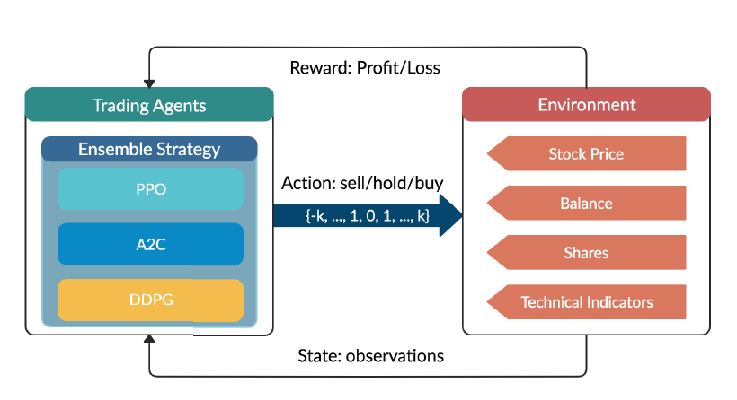
Ensemble Learning
In statistics and machine learning, ensemble methods use multiple learning algorithms to obtain better predictive performance than could be obtained from any of the constituent learning algorithms alone
The ensemble strategy inherits and integrates the best features of the algorithms, thereby robustly adjusting to different kind of situation.

Slide 4
Check list
Model stock trading as a Markov Decision Process (MDP) and formulate trading objective as a maximization of expected return.
Build an environment and define action space, state space, and reward function.
Train the three algorithms that take actions in the environment.
Ensemble the three agents together using the Sharpe ratio that measures the risk-adjusted return.
Effectiveness of the ensemble strategy is verified by its higher Sharpe ratio than both the min-variance portfolio allocation strategy and the Dow Jones Industrial Average(DJIA).

Slide 5
MDP Model for stock trading
State s = [p, h, b]: a vector that includes stock prices p, the stock shares h, and the remaining balance b.
Action a: a vector of actions over stocks. The allowed actions on each stock include selling, buying, or holding, which result in decreasing, increasing, and no change of the stock shares h, respectively.
Reward r(s; a; s0): the direct reward of taking action a at state s and arriving at the new state s0.
Policy (s): the trading strategy at state s, which is the probability distribution of actions at state s.
Q-value Q(s; a): the expected reward of taking action a at state s following policy .

Slide 6
Environment for Multiple Stocks
We use a continuous action space to model the trading of multiple stocks. We assume that our portfolio has 30 stocks in total.
State Space: We use a 181-dimensional vector consists of seven parts of information to represent the state space of multiple stocks trading environment: [b, p, h, M, R, C, X]
b is available balance, p is adjusted close price h is shares owned of each stock, M is MACD, R is RSI, C is CCI, X is ADX.
Action Space: For a single stock, the action space is defined as {-k, … , -1, 0, 1, …, k} where k and -k represents the number of shares we can buy and sell.

Slide 7
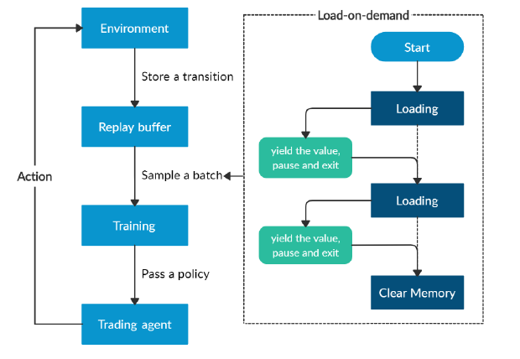
Memory Management
The memory consumption for training could grow exponentially with the number of stocks, data types, features of the state space, number of layers and neurons in the neural networks, and batch size. To tackle the problem of memory requirements, we employ a load-on-demand technique for efficient use of memory.

Slide 8
Ensemble Model
We use an ensemble strategy to automatically select the best performing agent among PPO, A2C, and DDPG to trade based on the Sharpe ratio. The ensemble process is described as follows:
We use a growing window of n months to retrain our three agents concurrently. Here we retrain our three agents at every three months.
We validate all three agents by using a 3-month validation rolling window after training window to pick the best performing agent with the highest Sharpe ratio.
After the best agent is picked, we use it to predict and trade for the next quarter.
The reason behind this choice is that each trading agent is sensitive to different type of trends. One agent performs well in a bullish trend but acts bad in a bearish trend. Another agent is more adjusted to a volatile market. The higher an agent’s Sharpe ratio, the better its returns have been relative to the amount of investment risk it has taken. Therefore, we pick the trading agent that can maximize the returns adjusted to the increasing risk.

Slide 9
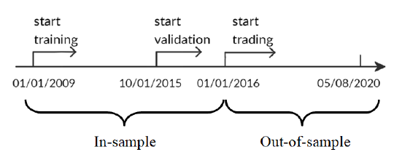
Dataset
We selected the Dow Jones 30 constituent stocks as our trading stock pool.
The whole dataset is split as shown in Figure. Data from 01/01/2009 to 09/30/2015 is used for training, and the data from 10/01/2015 to 12/31/2015 is used for validation and tuning of parameters. Finally, we test our agent’s performance on trading data, which is the unseen out of- sample data from 01/01/2016 to 05/08/2020.
To better exploit the trading data, we continue training our agent while in the trading stage, since this will help the agent to better adapt to the market dynamics.

Slide 10
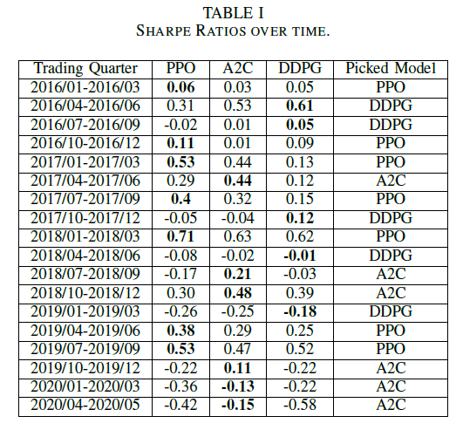
Performance Comparisons Agent Selection
Five metrics are used to evaluate our results:
Cumulative return: is calculated by subtracting the portfolio’s final value from its initial value, and then dividing by the initial value.
Annualized return: is the geometric average amount of money earned by the agent each year over the time period.
Annualized volatility: is the annualized standard deviation of portfolio return.
Sharpe ratio: is calculated by subtracting the annualized risk free rate from the annualized return, and the dividing by the annualized volatility.
Max drawdown: is the maximum percentage loss during the trading period.

Slide 11
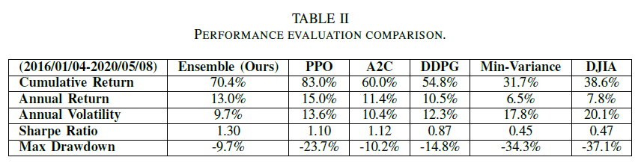
Performance Comparisons Analysis of Agent Performance
From both Table 2 and Figure 5, we can observe that the A2C agent is more adaptive to risk. It has the lowest annual volatility 10:4% and max drawdown -10:2% among the three agents. So A2C is good at handling a bearish market. PPO agent is good at following trend and acts well in generating more returns, it has the highest annual return 15:0% and cumulative return 83:0% among the three agents.

Slide 12
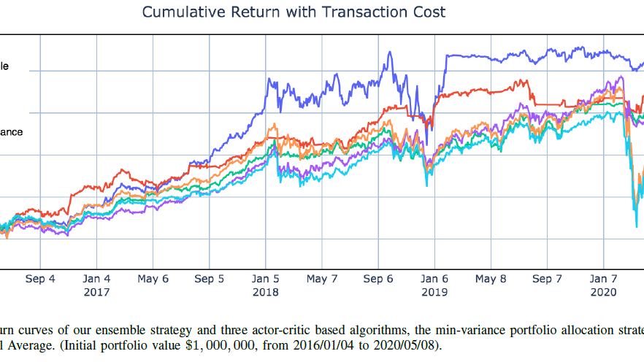
Analysis of Agent Performance Continue…
So PPO is preferred when facing a bullish market. DDPG performs similar but not as good as PPO, it can be used as a complementary strategy to PPO in a bullish market. All three agents’ performance outperform the two benchmarks, Dow Jones Industrial Average and in-variance portfolio allocation of DJIA, respectively.

Slide 13
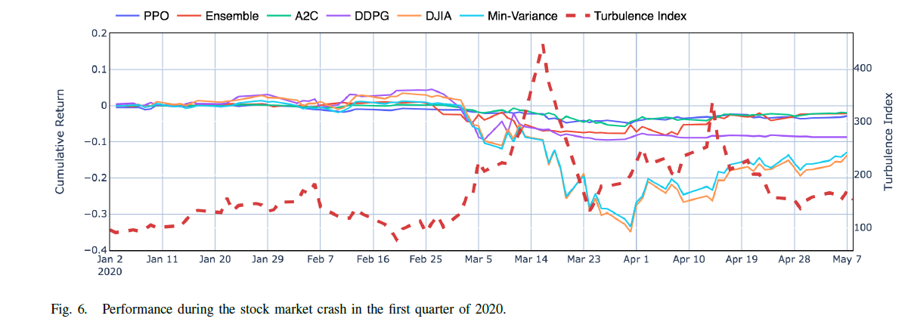
Performance Comparisons Performance under Market Crash
We can see that our ensemble strategy and the three agents perform well in the 2020 stock market crash event.
When the turbulence index reaches a threshold, it indicates an extreme market situation. Then our agents will sell off all currently held shares and wait for the market to return to normal to resume trading.
By incorporating the turbulence index, the agents are able to cut losses and successfully survive the stock market crash in March 2020. We can tune the turbulence index threshold lower for higher risk aversion.

Slide 14
Performance Comparisons Benchmark Comparison
Ensemble strategy significantly outperforms the DJIA and the min-variance portfolio allocation.
The ensemble strategy achieves a Sharpe ratio 1:30, which is much higher than the Sharpe ratio of 0:47 for DJIA, and 0:45 for the min-variance portfolio allocation.
The annualized return of the ensemble strategy is also much higher.
The annual volatility is much lower, indicating that the ensemble strategy beats both the DJIA and min-variance portfolio allocation in balancing risk and return.
The ensemble strategy also outperforms A2C with a Sharpe ratio of 1.12, PPO with a Sharpe ratio of 1.10, and DDPG with a Sharpe ratio of 0.87, respectively.

Slide 15
THANK YOU

